Slide 1
2014 Reykjavik Open Pub Quiz

Slide 2
Question #1
What is the FULL name of current World Champion Carlsen?

Slide 3
Question #2
What year did Steinitz become World Champion?

Slide 4
Question #3
Who said „Chess, like love, like music, has the power to make men happy“?

Slide 5
Question #4
After one move by each player in the game of chess how many possible positions are there?

Slide 6
Question #5
Name these chessplayers!

Slide 7
Question #6
Fischer invented Fischer-random chess but Capablanca also invented Capablanca-chess. How many squares are there on a board in Capablanca-chess in his initial version?

Slide 8
Question #7
In 1914 a Chess Master won the Geneva tournament. Later this player would lose all knowledge of chess as a result of trauma suffered in World War I. He remarkably later re-learned the game and managed to draw against Alekhine and beat Capablanca. A variation is name after this player in a opening which black answer 1.d4 with. Who is this player?

Slide 9
Question #8
What do these chess players have in common?

Slide 10
Question #9
Which brothers have the highest average rating in the world? (hint: It‘s not the Thorfinnsson brothers)

Slide 11
Question #10
What was the last venue of the Reykjavik Open before it was moved to it‘s current venue in Harpan?

Slide 12
Question #11
After the fall of the Soviet Union there have been 11 Olympiads, counting from and including Manila 1992. Three countries have been champions since that time, name them!

Slide 13
Question #12
In this position from the 1990 Reykjavik Open, who (and we ask that person if he is the audience not to reveal his name by laughing or other gestures) had the white pieces and what move did he make in this position which was considered as one of the top 100 most beautiful moves of the 20th century?

Slide 14
Question #13
Please place these chessplayers in descending order based on when they were born, i.e. Oldest first:
Bronstein, Byrne, Geller, Gligoric

Slide 15
Question #14
Alekhine was the 4th World Champion after Steinitz, Lasker & Capablanca. He died as defending champion in 1946. What year was the next World Champion crowned, who was it, and which players did he defeat in a tournament to become champion?

Slide 16
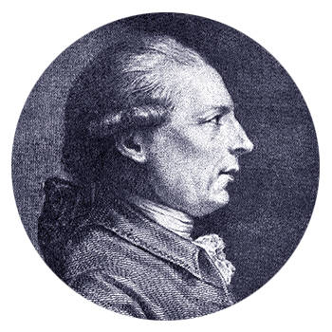
Question #15
Who is this? Hint: he might have openings and some other things named after him!

Slide 17
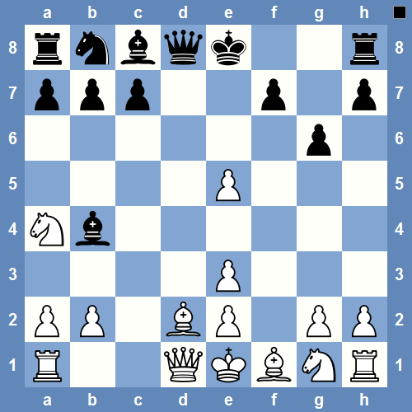
Question #16
From which opening did this position arise after 8 moves?

Slide 18
Question #17
What is the rating of the 50th highest rated player in the world as of the March 1st FIDE rating list? (of by +/- 3 points will be given as correct)

Slide 19
Question #18
When and where was the first Chess Olympiad held and who won?

Slide 20
Question #19
What is this mate called?

Slide 21
Question #20
We are asking for a ChessClub. This ChessClub was founded in 1822 and is the oldest in it‘s country and one of the oldest in the world. Among those who have visited the club are: Staunton, Capablanca, Alekhine and Karpov. Icelandic ChessClub Mátar visisted the club last year and defeated it.

Slide 22
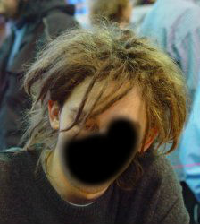
Question #21
Name this chessplayer (hint: He has played in the Reykjavik Open)

Slide 23
Question #22
Which country has won the most bronze medal at the mens Olympiad, how many times and when was their latest bronze Olympiad?

Slide 24
Question #23
Which chessplayer had this haircut for a number of years?

Slide 25
Question #24
Which South-American was World U-20 Champion in 1953 in Copenhagen and has a variation named after him?

Slide 26
Question #25
Which move was played in this position that resulted in a spectacular 23 moves victory for black and who were the players playing this game?

Slide 27
Question #26
This variation was introduced in round 14 of the Interzonal tournament in 1955. The Argentine trio of Panno, Pilnik and Najdorf played it against the Soviet trio of Geller, Spassky and Keres in three separate games. Despite the variation being a home preparation for black from the Argentinian players, all games were won by white, the Soviet players. What is the name of this variation?

Slide 28
Question #27
Which chess opening are we asking for here?

Slide 29
Question #28
This chess player was born in 1877. He mainly lived in two neighbouring countries and was one of the leading chess players of his continent. He has a few variations named after him, either attacks or gambits in general. He was also known for his tactical skills and saving lost positions with some „swindle“ was a speciality of his. He played one match for the World Championship where he lost. He died in 1944 after but his name will remain in the chess history for ages.

Slide 30
Question #29
Kasparov and Karpov played five World Championship matches 1984-1990, in all well over 100 games. Which two players played the 2nd most games against each other?

Slide 31
Question 30
Everybody knows that Tal won the first Reykjavik Open in 1964 if they have been paying any attention ;-)
Which two players came 2nd and 3rd?

Slide 32
Question 31
At the 2012 Olympiad in Istanbul, 157 teams participated in the open section which is quite a lot. But which Olympiad had the most teams participating in the open section?

Slide 33
Question #32
We ask for a chessplayer. This player won the British Championsihp in 1929, 1932 og 1933. About that time he was one of the strongest player in the world but never got an offical title from FIDE. He defeated among others Akiba Rubinstein and drew against Alekhine. From the middle to late thirties he seems to have given up playing and died in his hometown 1966 at the age of 61.

Slide 34
Question #33
When was Bobby Fischer born? (date and year)

Slide 35
Question #34
Which country (Iceland not included) has the most participants in the current 2014 Reykjavik Open?

