Slide 1
Chess Quiz 2013

Slide 2
Question 1
Which two players finished 1. - 2. at the recent group B of the Tata Steel Tournament 2013?

Slide 3
Question 2
In what city was the former World Champion and New Yorker Bobby Fischer born?

Slide 4
Question 3
In chemical the symbol for Sodium is Na but the Sodium is also a name for a chess opening. What is the first move for white in the Sodium?

Slide 5
Question 4
Despite its nearly 89 years history FIDE has had only 6 presidents. What year was the current president Kirsan Ilyumzhinov elected as the president of FIDE?

Slide 6
Question 5
In 1957 Vasily Smyslov became World Champion when he beat Botvinnik 12,5-9,5. How did Smyslov qualify for this WC match?

Slide 7
Question 6
In what of the following cities has the Chess Olympiad never been played, Havana, Stockholm, Skopje, Berlin or Tel Aviv?

Slide 8
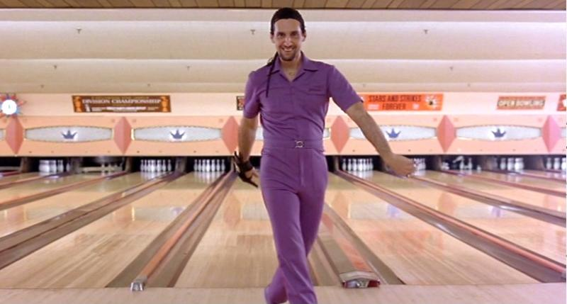
Question 7
This famous actor performed in the chess movie The Luzhin Defence. What is his name?

Slide 9
Question 8
What are the family names of these two GM‘s: Boris Abramovich and Mikhail Nekhemievich

Slide 10
Question 9
In the middle of March this year the candidates‘ tournament for the Wold Chess Championship will be held in London. In this tournament the challenger for the World Champion will be decided. How many players will be playing in this tournament?

Slide 11
Question 10

Slide 12
Question 10 cont.
This opening is known by the name Albin Countergambit. What was this Albin?

Slide 13
Question 11
The Lone Pine tournament was held in California for a decade and it was a strong semi-open tournament with high prize pot. The last tournament was held in 1981 and this was the first tournament in which players from the Soviet Union competed with Viktor Korchnoi since his defection from the Soviet Union. What year did Korchnoi defect the Soviet Union?

Slide 14
Question 12
This chessplayer was born in Kiev which was at that time part of the Russian Empire. He died 63 years later in West Germany after enjoying a successful career as a chessplayer where he among other achievements won the Soviet Championship two times and got an opening named after him. He was also quoted as saying „When I am white I win because I am white. When I am black I win because I am xxx“. Who was he?

Slide 15
Question 13
In his career Garry Kasparov played at 8 Olympiads winning gold on each of them. His score was +50 -3 =29 on these 8 Olympiads. Can you name one player he lost against?

Slide 16
Question 14
Who was the author of the best selling book Secrets of Modern Chess Strategy?

Slide 17
Question 15
Who was the winner of the recent 2013 Armenian Championship?

Slide 18
Question 16
The musical named Chess is about American and Russian chessplayers and a love triangle they have with a woman. In what famous band were the authors of the music in Chess?

Slide 19
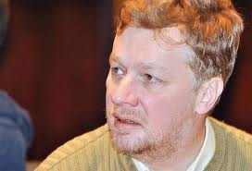
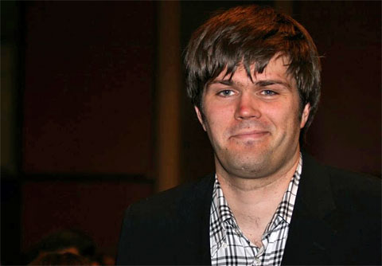
Questions 17-18
Who are they?

Slide 20
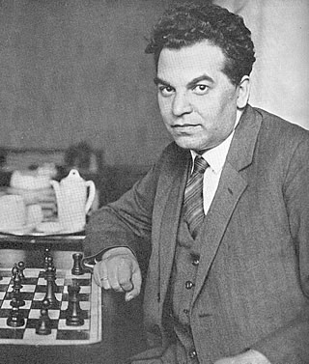
Questions 17-18 cont.

Slide 21
Question 19
Who is currently the highest rated Georgian chess player?

Slide 22
Question 20
This chessplayer was nicknamed by no other than Anatoly Karpov as the “World Champion of amateurs” and he was one of the strongest chess player of his nation for a quarter of a century. Despite being a strong GM he rather wanted to work as a lawyer but he nevertheless represented his country at 12 Olympiads and he also won his country’s Championship 6 times. He once played a match agains Keres where they played the Ruy Lopez on all 8 games. He also beat several very strong players as Fischer, Botvinnik, Tal, Keres and Korchnoi. Who was he?

Slide 23
Question 21
Of all the World Champions in the history of chess, who has had the longest life?

Slide 24
Question 22
The introduction to the posthumous biography Emanuel Lasker, the life of a chess master was written by a very famous academic who also played some chess but was famous for some different things. Who was this man?

Slide 25
Question 23
What teams are the current Olympiad Champions in the Open section and the Women section?

Slide 26
Question 24

Slide 27
Question 24 cont.
This is the final position of a very important game. What game was that?

Slide 28
Question 25

Slide 29
Question 25 cont.
This position is the final position of the final game in the match between Spassky and Fischer in 1972. Fischer won this game and thereby the match. How many games did Fischer win in this match?

Slide 30
Question 26
Who is currently the oldest living Grand Master in the world?

Slide 31
Question 27
In the post Soviet era, how many women’s World Champions has Russia had?

Slide 32
Question 28
The Encyclopaedia of Chess Openings (ECO) has been around for many years and it lays the ground for us methodically sorting the chess openings into A, B, C, D and E. This coding system has now been widely adopted around the chess publications. From where does the ECO come?

Slide 33
Question 29
From what former Soviet Union Republic do Nona Gaprindashvili and Maya Chiburdanidze come from?

Slide 34
Question 30
This opening has been used in several WC mathces and it has had some revival in recent years although it is not seen so often at the very top level. Some players play this opening game after game while other players cannot understand why anyone would want to play this opening. Therefor the name seems very fitting as it is a Hebrew meaning „son of my sorrow“(Genesis 35:18). What is the common name for this opening?

Slide 35
Answers
1. Arkadij Naiditsch and Richard Rapport (9/13).
2. Bobby Fischer was born in Chicago, Illinois.
3. The first move in the Sodium is 1. Na3 (also known as the Durkin).
4. Kirsan was elected in 1995.
5. Smyslov qualified by winning the 10 players‘ Candidates Tournament in Amsterdam 1956.

Slide 36
Answers
6. The Chess Olympiad has never been in Berlin (Havana 1966, Stockholm 1937, Skopje 1972 and Tel Aviv 1964).
7. John Turturro.
8. Gelfand and Tal.
9. 8 players.
10. Albin was Adolf Albin a Romanian chessplayer.
11. Korchnoi defected in 1976.

Slide 37
Answers
12. Efim Bogoljubov.
13. GK lost K. Georgiev in 1980, Y. Seirawan in ‘86 and Topalov in ‘94.
14. IM John Watson
15. Tigran L. Petrosian
16. The music in Chess is from Benny Andersson and Björn Ulvaeus from ABBA.
17-18. Alexander Khalifman, PH. Nielsen, Marie Sebag and Richard Réti.

Slide 38
Answers
19. Baadur Jobava (2702).
20. Wolfgang Unzicker.
21. Vasily Smyslov (aged 89).
22. Albert Einstein
23. Armenia and Russia.
24. Vladimir Kramnik – Peter Leko, 2004. 14th and last game of WC match in 2004 (enough to say last game of WC match between VK-PL).

Slide 39
Answers
25. Fischer won 7 games in the 1972 match.
26. Yuri Averbakh, 91 years old.
27. 1 (Kosteniuk 2008-2010).
28. ECO and the coding system comes from the Chess Informant in Belgrade.
29. Georgia
30. Benoni Defence

