Slide 1
Chess Quiz 2012

Slide 2
Question 1
Who was the winner of the recent Tata Steel Tournament?

Slide 3
Question 2
Pal Benko and Mark Taimanov are two GM’s born in the 1920’s. Who is the older one?

Slide 4
Question 3
Recently the book A journey Through one Brilliant Career was published. Whose brilliant career is covered in the book?

Slide 5
Question 4
The last 3 Linares tournaments, held in 2008, 2009 and 2010 respectively, were 6 – 8 players tournaments. What category were these 3 tournaments, they were all in the same category? Each category is 25 rating points wide and the highest category is 22 with average rating between 2776 – 2800.

Slide 6
Question 5
In 2002 he was the youngest ever to make it to the FIDE top 100 players list at the age of 14. In 2003 he beat three former/reigning FIDE World Champions with the black pieces and in 2004 he reached the semi-finals at the FIDE World Chess Championship. Now in March 2012 he has his peak rating, who is this player?

Slide 7
Question 6
Lev Polugaevsky is one of the big names of the chess history. From what former Soviet Union republic was Polugaevsky?

Slide 8
Question 7
The Winawer variation of the French Defence is quite a popular variation. What is this Winawer?

Slide 9
Question 8
Russia has not won the Chess Olympiad since 2002 in Slovenia. Who was playing on board 1 in the Russian team on that occasion?

Slide 10
Question 9
In 1967 Bobby Fischer lost two times with the white pieces agains the same opponent and neither times did he manage 25 moves. Who beat Fischer so badly?

Slide 11
Question 10
Which former world champion entered the Sorbonne Faculty of law and wrote thesis on the Chinese prison system?

Slide 12
Question 11
The 2010 Pearl Spring tournament in China was the first tournament ever to host 3 players rated at least 2800. Which players were that?

Slide 13
Question 12
When Bobby Fischer famously became World Champion in 1972, he beat Spassky in Reykjavik. Where was the semi-final match against Petrosian played?

Slide 14
Question 13
What is the middle name of Gary Kasparov?

Slide 15
Question 14
Hou Yifan is the current Women’s World Champion. Who was the last Women’s World Champion before her?

Slide 16
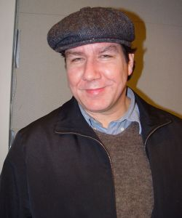
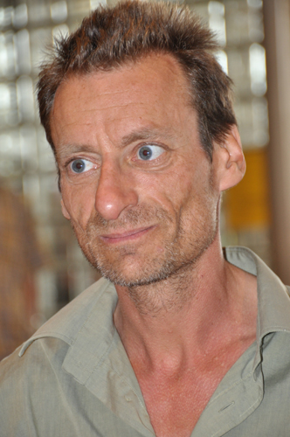
Question 15-16
Who are they?

Slide 17
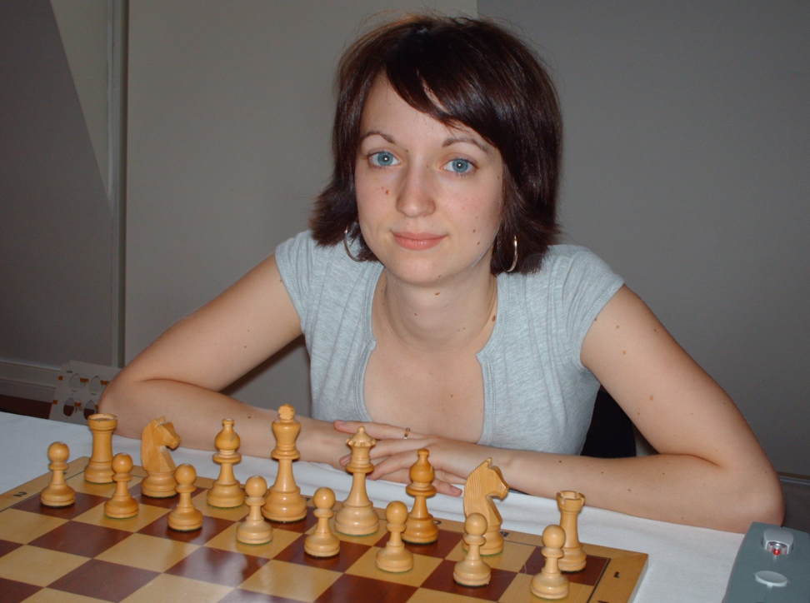
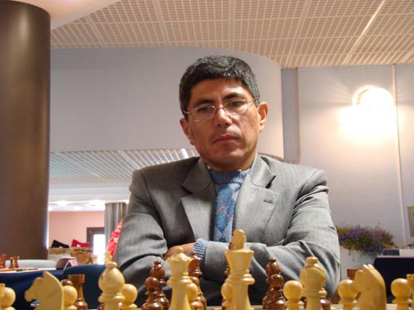
Question 15-16
Who are they?

Slide 18
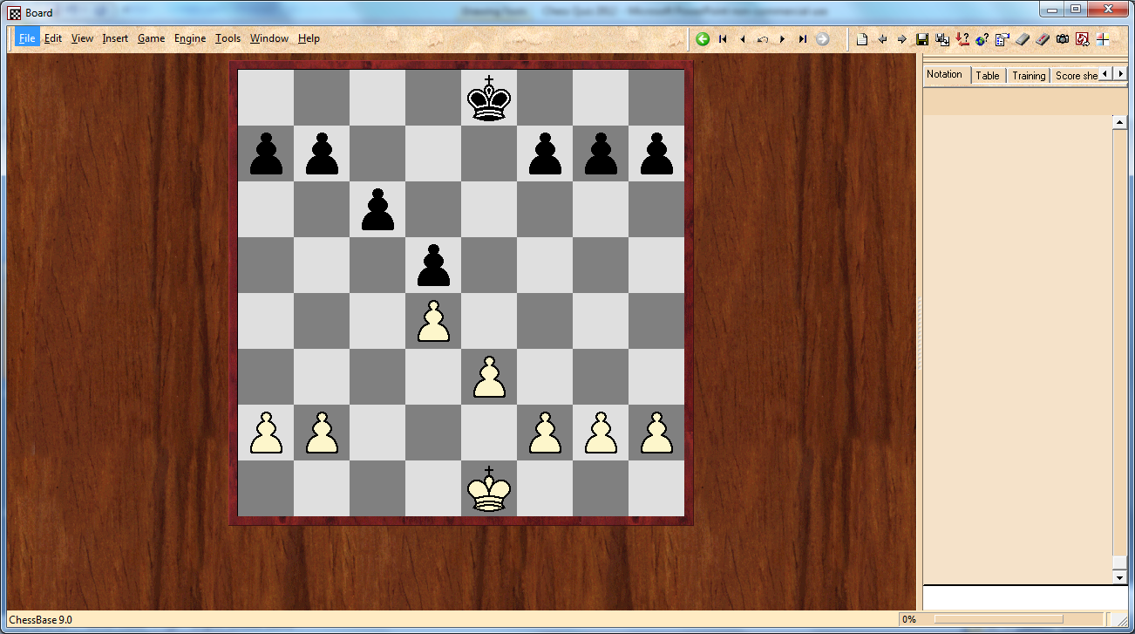
Question 17
What is the name of this pawn structure:

Slide 19
Question 18
The current World Champion challenger is Boris Gelfand. For how many teams has Gelfand played at the Chess Olympiad?

Slide 20
Question 19
Who is the current Head of the Management Board of the Russian Chess Federation and a former co-author of the book From London to Elista?

Slide 21
Question 20
This chessplayer was a doctor in phsychology, university professor, author and he won the US Open Championship 7 times. He was born in the US but his family was Russian-Jewish. Despite his successes at the US Open Championship, he never managed to win the US Championship, narrowly losing it to Sammy Reshevsky on several occasions. Who was this chessplayer?

Slide 22
Question 21
Emanuel Lasker is the World Champion which has hold the title for the longest time. When he first became World Champ he was living in the German Empire and when his reign ended it had become the Weimar Republic. How long was Emanuel Lasker World Champion?

Slide 23
Question 22
Among the players here at the Reykjavik Open is GM Boris Avrukh from Israel. He is a strong GM and author of several best selling books. For what publishing company did he write is famous GM Repertoire 1. d4 books and what was the cover of volume 1 like?

Slide 24
Question 23
On which famous played did Botvinnik say: “The boy doesn’t have a clue about chess and there’s no future at all for him in this profession.”?

Slide 25
Question 24
Where was the 1988 Chess Olympiad and what team won the open section?

Slide 26
Question 25
Which of these chessplayers was not the youngest GM at the time, when he/she became Grand Master: Bobby Fischer, Judit Polgar, Peter Leko, Levon Aronian and Sergey Karjakin?

Slide 27
Question 26
This famous endgame was played in a very important game. Who were playing and what year?

Slide 28
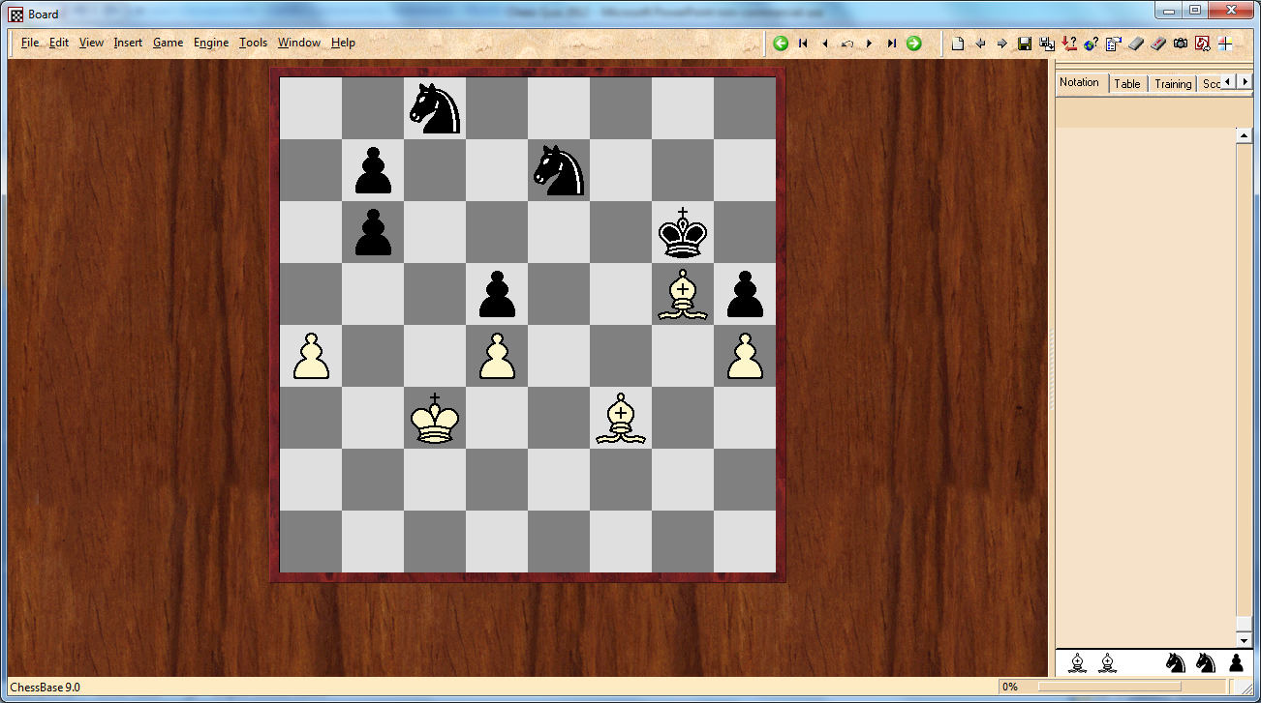
Question 26 cont.

Slide 29
27
The Soviet Union and then Russia has dominated the European Team Championship over the years. What country has got the second mot European Team’s titles?

Slide 30
28
In how many continents have the World Championship matches been held? All the FIDE matches and other matches from the 1993 split shall be counted for.

Slide 31
Question 29
Which US president played chess for the Georgetown University team in 1968?

Slide 32
Question 30
In 1969 Boris Spassky became the World Champion after beating Petrosian in a match. Which player did he beat in the last candidates match and by what margin?

Slide 33
Answers
1. Levon Aronian.
2. Taimanov, born 1926 (Benko born 1928).
3. Ljubomir Ljubojevic’s career.
4. Category 21 (average rating 2756, 2756 and 2758)
5. Teimour Radjabov, 2784.
6. Polugaevsky was from Belorussia.
7. Winawer was a chessplayer from Poland, Szymon Abramowicz Winawer (1838 – 1920).

Slide 34
Answers cont.
8. Gary Kasparov.
9. Efim Geller.
10. Alexander Alekhine.
11. Magnus Carlsen, Vishy Andand and Veselin Topalov. (0 points for one correct player, 0,5 for 2 correct players)
12. In Buenos Aires, Argentine.
13. Gary Kimovich Kasparov.

Slide 35
Answers cont.
14. Alexandra Kosteniuk.
15. Larry Christiansen, Manuel Bosboom
16. Elisabeth Paethz, Julio Granda Zuniga.
17. Carlsbad pawn structure.
18. 3. 1990 USSR, 1994-96 Belorussia and from 2000 Israel.
19. Ilya Levitov.
20 Reuben Fine

Slide 36
Answers cont.
21. 27 years, from 1894-1921.
22. Quality Chess was the publisher and the cover was the Israel flag (and chess board with 1. d4, Israel flag is enough).
23. Anatoly Karpov
24. Thessaloniki, Greece and USSR won.
25. Levon Aronian, GM at age 17.
26. Botvinnik – Bronstein, game 23. 1951

Slide 37
Anwers cont.
27. The Netherlands (two times).
28. 5 continents (Capablanca – Alekhine 1927 in Buenos Aires. Karpov – Korchnoi 1978 Baguio, Philippines. Kasimdzhanov – Adams 2004, Tripoli, Lybia.)
29. Bill Clinton.
30. He beat Korchnoi by 3 points (6,5-3,5).

